Slide 1
Analytic Hierarchy Process

Slide 2
AHP
Information is decomposed into a hierarchy of alternatives and criteria
Information is then synthesized to determine relative ranking of alternatives
Both qualitative and quantitative information can be compared using informed judgements to derive weights and priorities

Slide 3
AHP-General Idea
Develop an hierarchy of decision criteria and define the alternative courses of actions.
AHP algorithm is basically composed of two steps:
  1. Determine the relative weights of the decision criteria
  2. Determine the relative rankings (priorities) of alternatives
! Both qualitative and quantitative information can be compared by using informed judgments to derive weights and priorities.

Slide 4
Example: Mobile Selection
Objective
  Selecting a mobile
Criteria
  Price, storage space, Camera, Looks?
Alternatives
  Mobile1, Mobile2, Mobile3, Mobile4 ….
Notes:
2

Slide 5
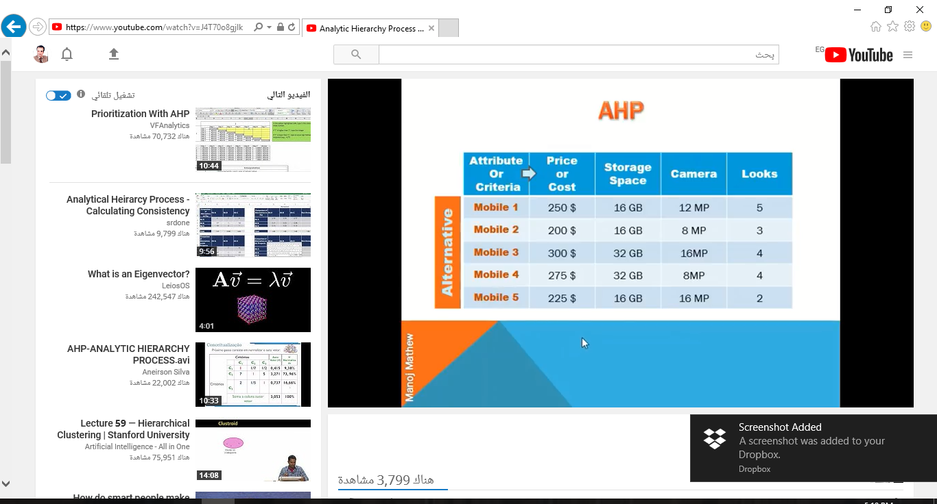

Slide 6
Ranking of criteria
Weights?
AHP
  pair-wise comparison matrix
  a_{ij} = a_{i}/a_{j}
  = weight of row (i) criterion to relative to weight of column (j) criterion
  a_{ij} = [1:Equal, 3:Moderate, 5:Strong,
  7:Very strong, 9:Extreme]
Notes:
4

Slide 7
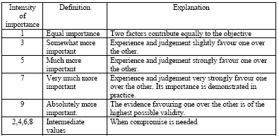
Ranking Scale for Criteria and Alternatives

Slide 8
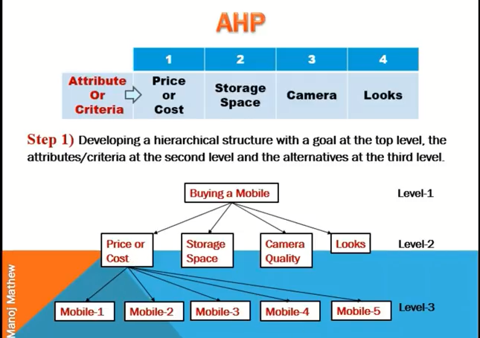

Slide 9
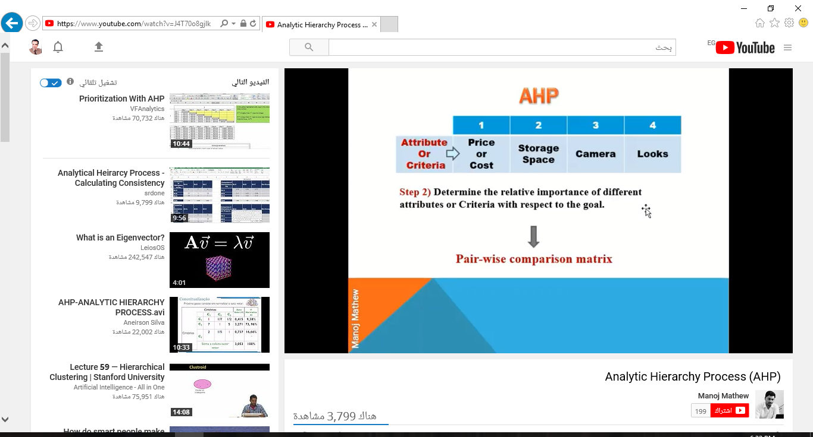

Slide 10
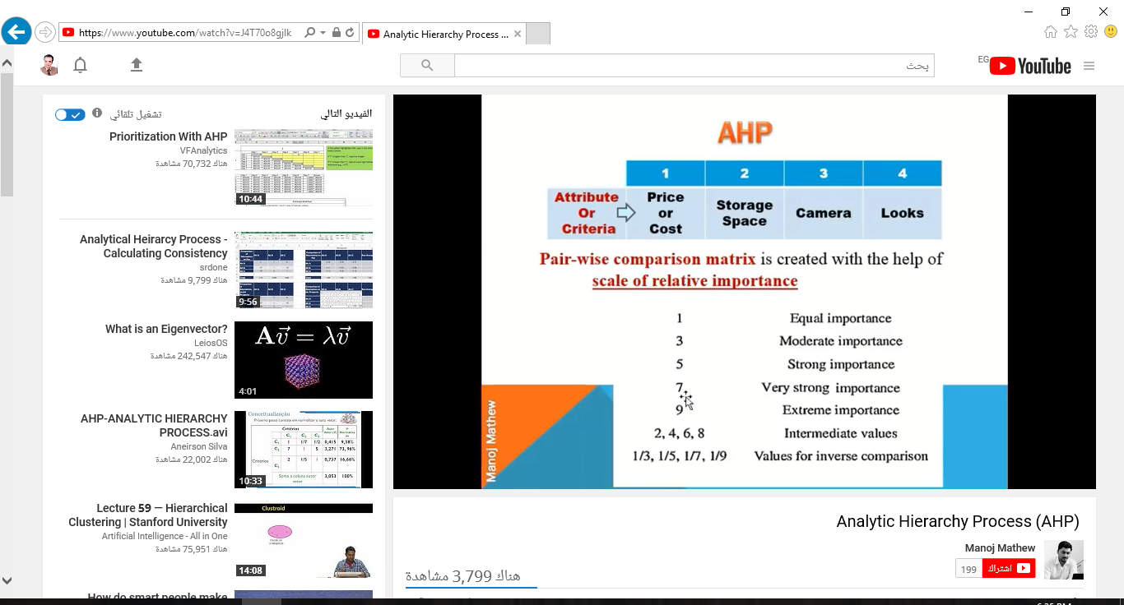

Slide 11
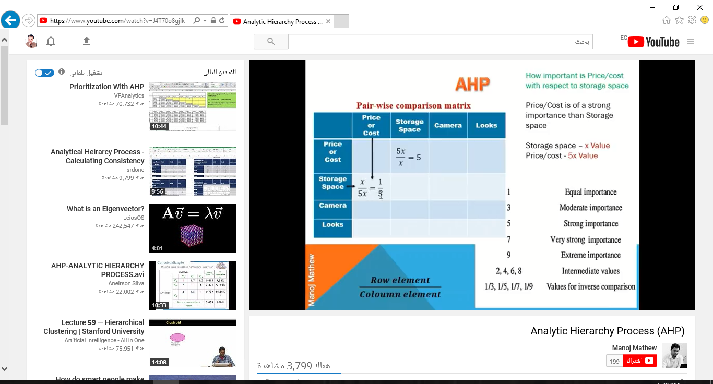

Slide 12


Slide 13


Slide 14


Slide 15
Example: Car Selection
Objective
  Selecting a car
Criteria
  Style, Reliability, Fuel-economy Cost?
Alternatives
  Civic Coupe, Saturn Coupe, Ford Escort, Mazda Miata
Notes:
2

Slide 16
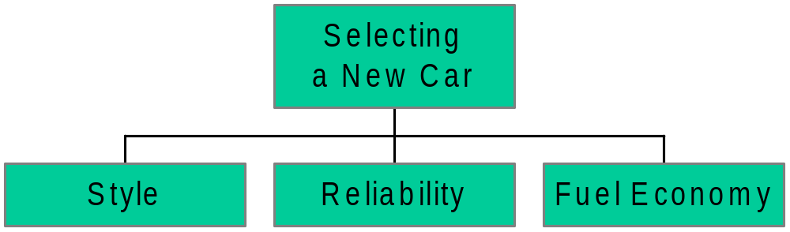
Hierarchical tree
- Civic
- Saturn
- Escort
- Miata
- Civic
- Saturn
- Escort
- Miata
- Civic
- Saturn
- Escort
- Miata
Notes:
3

Slide 17
Ranking of criteria
  Pair-wise relative importance
Style
Reliability
Fuel Economy
Style
1/1 1/2 3/1
Reliability
2/1 1/1 4/1
Fuel Economy
1/3 1/4 1/1
Notes:
4

Slide 18
Ranking of priorities
S R F
S
R
F
Row sums
4.5
7
1.58333
13.08333
Normalized
Row sums
0.344
0.535
0.121
1.0
1 0.5 3
2 1 4
0.333 0.25 1.0
Notes:
5

Slide 19
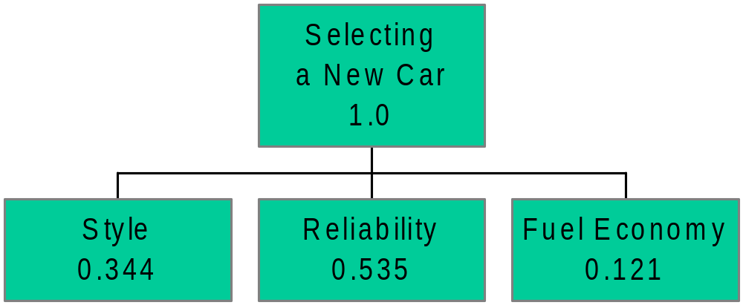
الأفضلية Preference
Style 0.344
Reliability 0.535
Fuel Economy 0.121
Notes:
7

Slide 20
Ranking alternatives
1. Style
Row
sum
Normalized
row sum
Style
Civic
Saturn
Escort
Miata
Civic
1/1 1/4 4/1 1/6 5.417
0.167
0.286
0.053
0.494
Saturn
4/1 1/1 4/1 1/4 9.25
Escort
1/4 1/4 1/1 1/5 1.7
Miata
Miata
6/1 4/1 5/1 1/1 16
Σ
32.367
1.0
Notes:
8

Slide 21
Ranking alternatives
2. Reliability
Row
sum
Normalized
row sum
Reliability
Civic
Saturn
Escort
Miata
Civic
1/1 2/1 5/1 1/1 9
0.378
0.273
0.075
0.273
Saturn
1/2 1/1 3/1 2/1 6.5
Escort
1/5 1/3 1/1 1/4 1.783
Miata
1/1 1/2 4/1 1/1 6.5
Σ
23.783
1.0
Notes:
8

Slide 22
Ranking alternatives
3. Fuel Economy
Miles/gallon
Normalized
Fuel Economy
(quantitative
information)
Civic
34
0.301
Saturn
27
0.239
Escort
24
0.212
Miata
Miata
28
113
0.248
1.0
Notes:
9

Slide 23
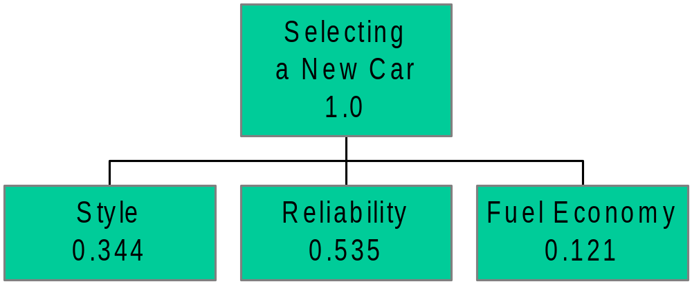
- Civic 0.167
- Saturn 0.286
- Escort 0.053
- Miata 0.494
- Civic 0.378
- Saturn 0.273
- Escort 0.075
- Miata 0.273
- Civic 0.301
- Saturn 0.239
- Escort 0.212
- Miata 0.248
Notes:
10

Slide 24
Overall Ranking of alternatives
Style Reliability Fuel
Economy
Civic
0.167 0.378 0.301
0.286 0.273 0.239
0.053 0.075 0.212
0.494 0.273 0.248
0.344
0.535
0.121
0.296
0.273
0.084
0.346
Saturn
*
=
Escort
Best
Miata
Miata
Notes:
11

Slide 25
AHP Eigenvector Method
Objective
  Eliminates inconsistency (errors) in pair-wise comparisons
Applies
  To ranking (weights) of criteria
  To ranking (scores) of alternatives under each criteria
Approach
  Iterative
Notes:
2

Slide 26
Ranking of priorities
Eigenvector [Ax = λx]
  Iterate
  1. Take successively higher powers of matrix A = {a_{ij} = a_{i}/a_{j}}
  2. Normalize the row sums
  Continue until difference between successive row sums is less than a pre-specified value
Notes:
5

Slide 27
Car Selection Example:
Hierarchical tree
- Civic
- Saturn
- Escort
- Miata
- Civic
- Saturn
- Escort
- Miata
- Civic
- Saturn
- Escort
- Miata
Notes:
3

Slide 28
Ranking of criteria
  Pair-wise relative importance
  Matrix A
Style
Reliability
Fuel Economy
Style
1/1 1/2 3/1
Reliability
2/1 1/1 4/1
Fuel Economy
1/3 1/4 1/1
Notes:
4

Slide 29
Ranking of criteria
Errors in pair-wise matrix A
Style
Reliability
Fuel Economy
Style
1/1 1/2 3/1
Reliability
2/1 1/1 4/1
Fuel Economy
1/3 1/4 1/1
Sum
10/3 7/4 8
Normalized
Style
0.3 0.286 0.375
Weights
(rows) not
consistent
Reliability
0.6 0.571 0.5
Fuel Economy
0.1 0.143 0.125
Notes:
4

Slide 30
Ranking of priorities
Matrix A
S R F
S
R
F
Row sums
4.5
7
1.583
13.083
Normalized
Row sums
0.344
0.535
0.121
1.0
1 0.5 3
2 1 4
0.333 0.25 1.0
Notes:
5

Slide 31
Ranking of priorities
Matrix A²
S R F
S
R
F
Row sums
12.75
23.333
4.833
39.917
A² Row
sums
0.319
0.559
0.121
1.0
A Row
sums
0.344
0.535
0.121
1.0
Diff. in
sums
- 0.025
0.024
0
3 1.75 8
5.333 3 14
1.167 0.667 3
Notes:
5

Slide 32
Ranking of priorities
Matrix A³
S R F
S
R
F
Row sums
38.417
67.167
14.667
120.25
A³ Row
sums
0.319
0.559
0.122
1.0
A Row
sums
0.319
0.559
0.121
1.0
Diff. in
sums
0
0
0.001
9.167 5.25 24
16 9.167 42
3.5 2 9.167
Notes:
5

Slide 33
Preference
Style 0.319
Reliability 0.559
Fuel Economy 0.122
Selecting
a New Car
1.0
Style
0.319
Reliability
0.559
Fuel Economy
0.122
Notes:
7

Slide 34
Ranking alternatives
1. Style
Matrix A
Row
sum
Normalized
row sum
Style
Civic
Saturn
Escort
Miata
Civic
1/1 1/4 4/1 1/6 5.417
0.167
0.286
0.053
0.494
Saturn
4/1 1/1 4/1 1/4 9.25
Escort
1/4 1/4 1/1 1/5 1.7
Miata
Miata
6/1 4/1 5/1 1/1 16
Σ
32.367
1.0
Notes:
8

Slide 35
Ranking alternatives
1. Style
Matrix A²
Row
sum
Norm.
row sum
A² - A
row sum
Style
C
S
E
M
Civic
4 2.167 9.833 1.196 17.196
0.106
0.258
0.053
0.582
-0.061
-0.028
0
0.088
Saturn
10.5 4 25.25 1.967 41.717
Escort
2.7 1.363 4 0.504 8.567
Miata
Miata
29.25 10.75 50 4 94
Σ
161.48
1.0
Notes:
8

Slide 36
Ranking alternatives
1. Style
Matrix A³
Row
sum
Norm.
row sum
A³ - A²
row sum
Style
C
S
E
M
Civic
22.3 10.408 40.479 4.371 77.558
0.112
0.242
0.061
0.586
0.006
-0.016
0.008
0.004
Saturn
44.613 20.804 93.083 9.667 168.27
Escort
12.175 5.054 22.771 2.095 42.095
Miata
Miata
108.75 46.563 230 21.563 406.88
Σ
694.79
1.0
Notes:
8

Slide 37
Ranking alternatives
1. Style
Style
Eigenvector
Civic
Saturn
Escort
Miata
Civic
1/1 1/4 4/1 1/6
0.1160
0.2470
0.0600
0.5770
Saturn
4/1 1/1 4/1 1/4
Escort
1/4 1/4 1/1 1/5
Miata
Miata
6/1 4/1 5/1 1/1
Notes:
8

Slide 38
Ranking alternatives
2. Reliability
Reliability
Eigenvector
Civic
Saturn
Escort
Miata
Civic
1/1 2/1 5/1 1/1
0.3790
0.2900
0.0740
0.2570
Saturn
1/2 1/1 3/1 2/1
Escort
1/5 1/3 1/1 1/4
Miata
1/1 1/2 4/1 1/1
Notes:
8

Slide 39
Ranking alternatives
3. Fuel Economy
Miles/gallon
Normalized
Fuel Economy
(quantitative
information)
Civic
34
0.301
Saturn
27
0.239
Escort
24
0.212
Miata
Miata
28
113
0.248
1.0
Notes:
9

Slide 40
Selecting
a New Car
1.0
Style
0.3196
Reliability
0.5584
Fuel Economy
0.1220
- Civic 0.116
- Saturn 0.247
- Escort 0.060
- Miata 0.577
- Civic 0.379
- Saturn 0.290
- Escort 0.074
- Miata 0.257
- Civic 0.301
- Saturn 0.239
- Escort 0.212
- Miata 0.248
Notes:
10

Slide 41
Overall Ranking of alternatives
Style Reliability Fuel
Economy
Civic
0.116 0.379 0.301
0.247 0.290 0.239
0.060 0.074 0.212
0.577 0.257 0.248
0.3196
0.5584
0.1220
0.306
0.272
0.094
0.328
Saturn
*
=
Escort
Best
Miata
Miata
Notes:
11

Slide 42
Handling Costs
Dangers of including Cost as another criterion
  political, emotional responses?
Separate Benefits and Costs hierarchical trees
Costs vs. Benefits evaluation
  Alternative with best benefits/costs ratio
Notes:
12

Slide 43
Cost vs. Benefits
Normalized
Cost
Cost/Benefits
Ratio
Cost
MIATA $18K 0.333 0.9840
CIVIC $12K 0.222 1.3771
SATURN $15K 0.2778 0.9791
ESCORT $9K 0.1667 0.5639
Σ
54K
1.0
Notes:
13

Slide 44
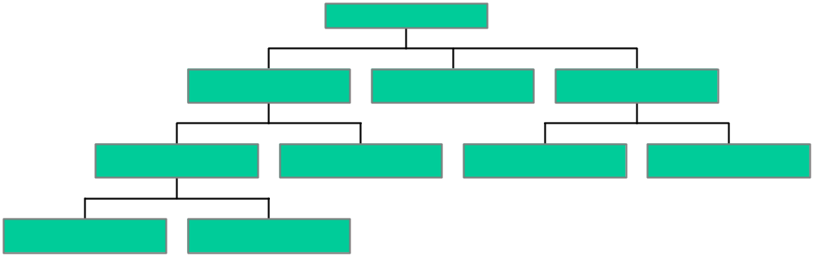
Complex decisions
Many levels of criteria and sub-criteria

Slide 45
Application areas
  strategic planning
  resource allocation
  source selection, program selection
  business policy
  etc., etc., etc..
AHP software (ExpertChoice)
  computations
  sensitivity analysis
  graphs, tables
Group AHP

